Slide 1
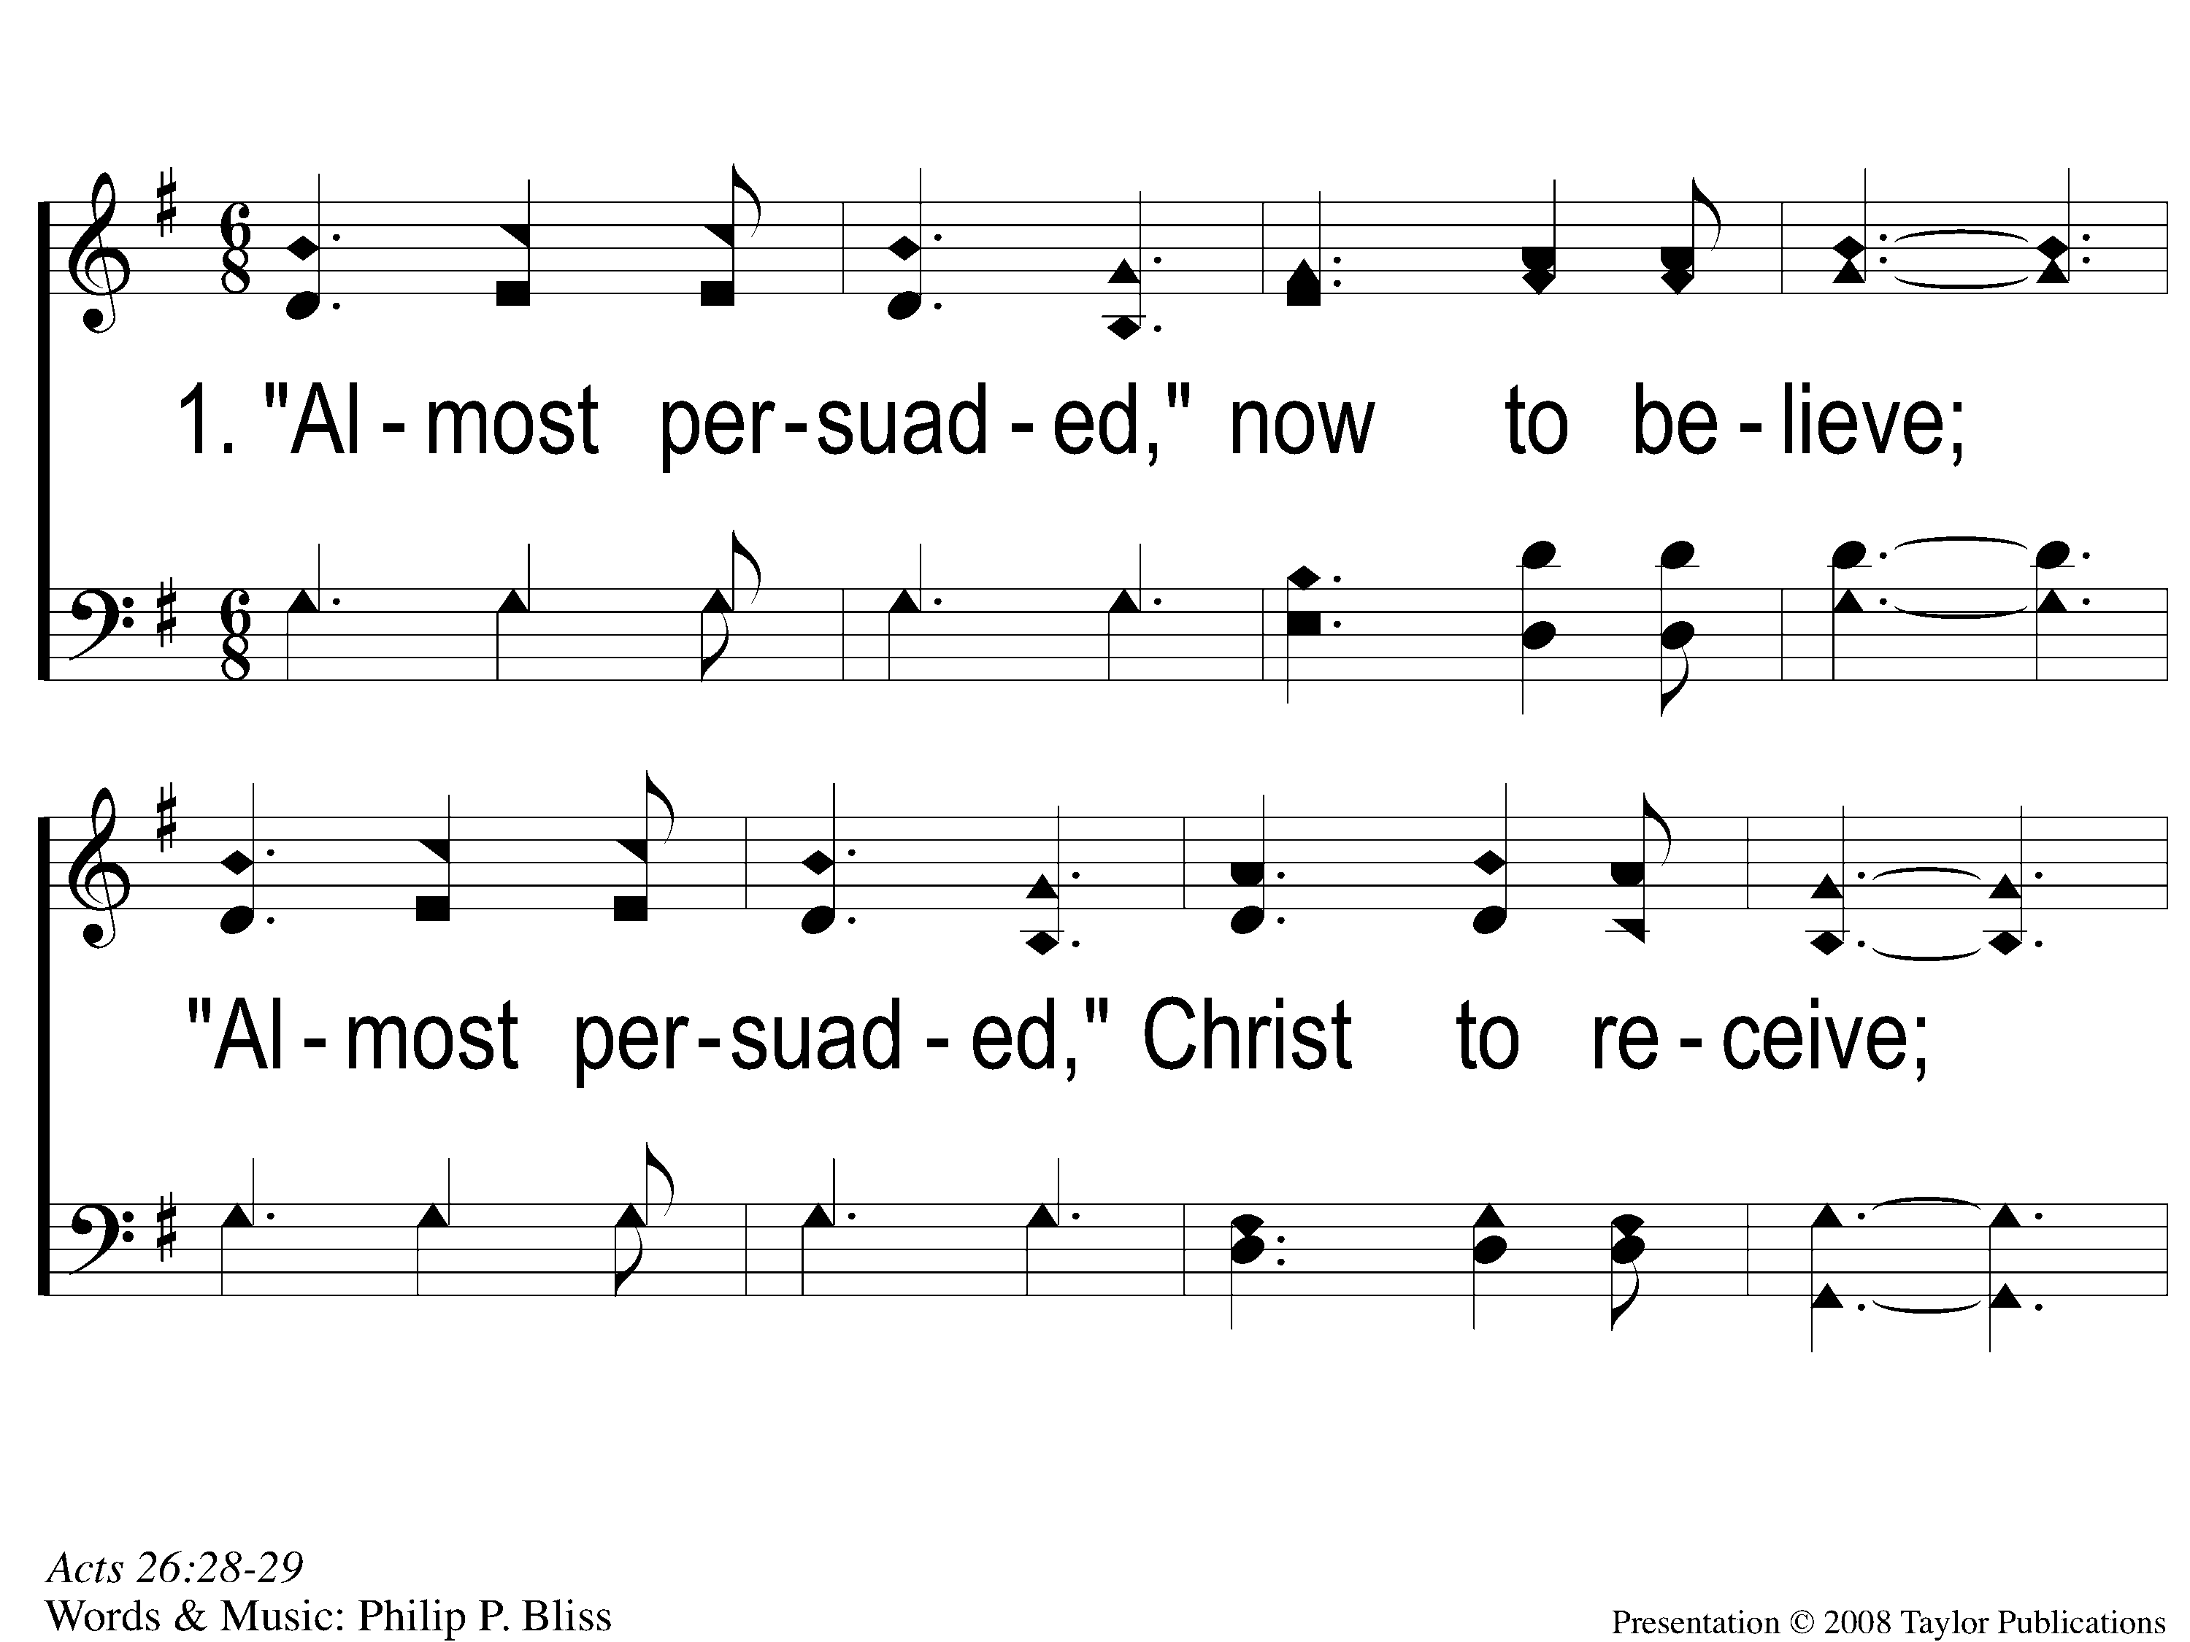
1-1 Almost Persuaded
Almost Persuaded
21

Slide 2
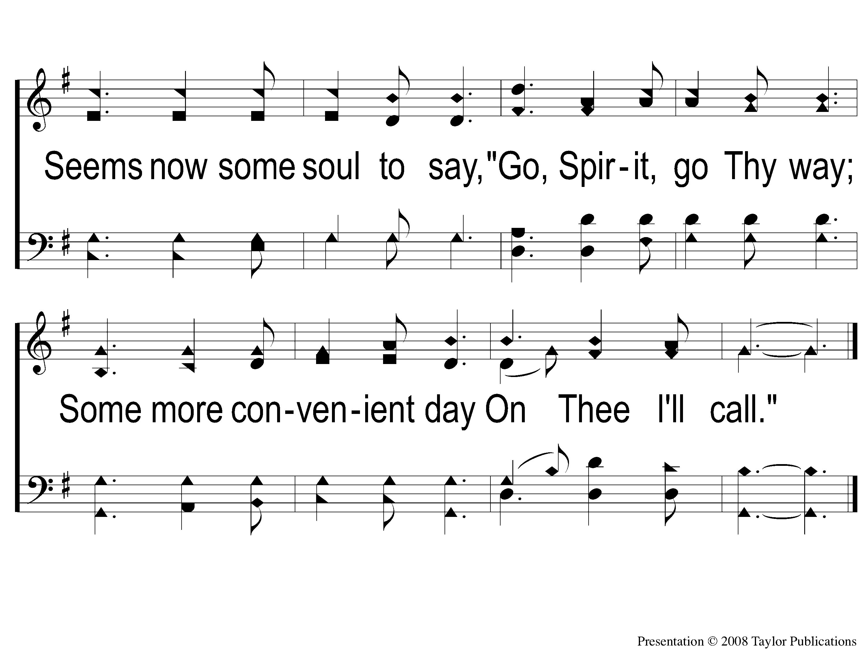
1-2 Almost Persuaded
Almost Persuaded
21

Slide 3
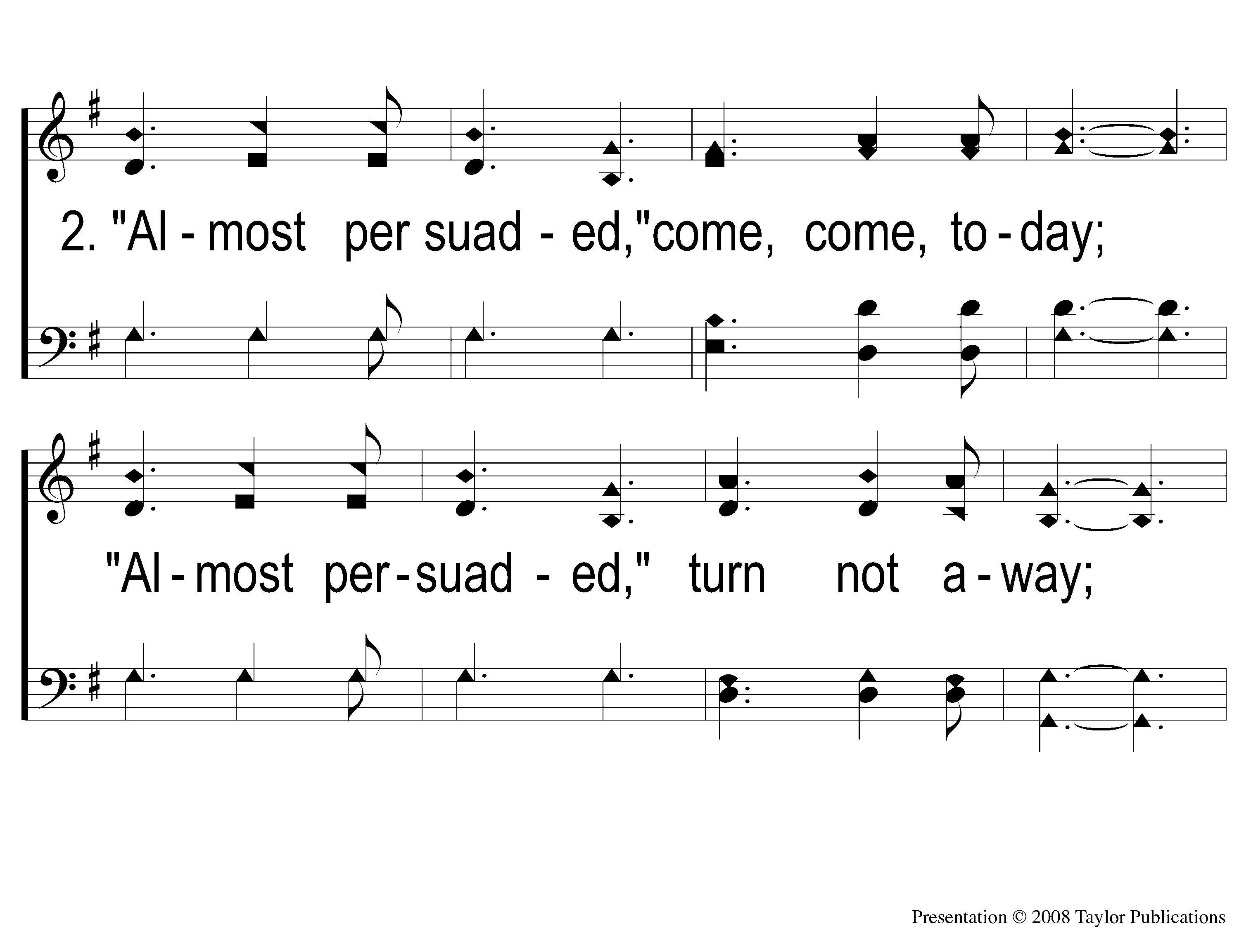
2-1 Almost Persuaded
Almost Persuaded
21

Slide 4
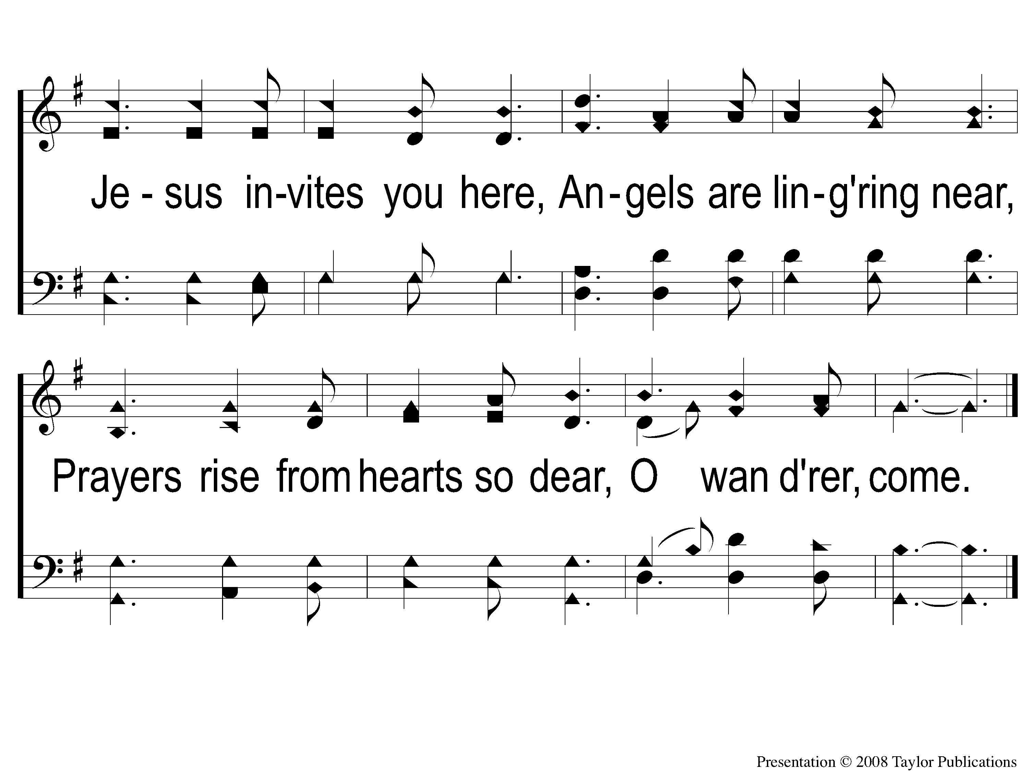
2-2 Almost Persuaded
Almost Persuaded
21

Slide 5
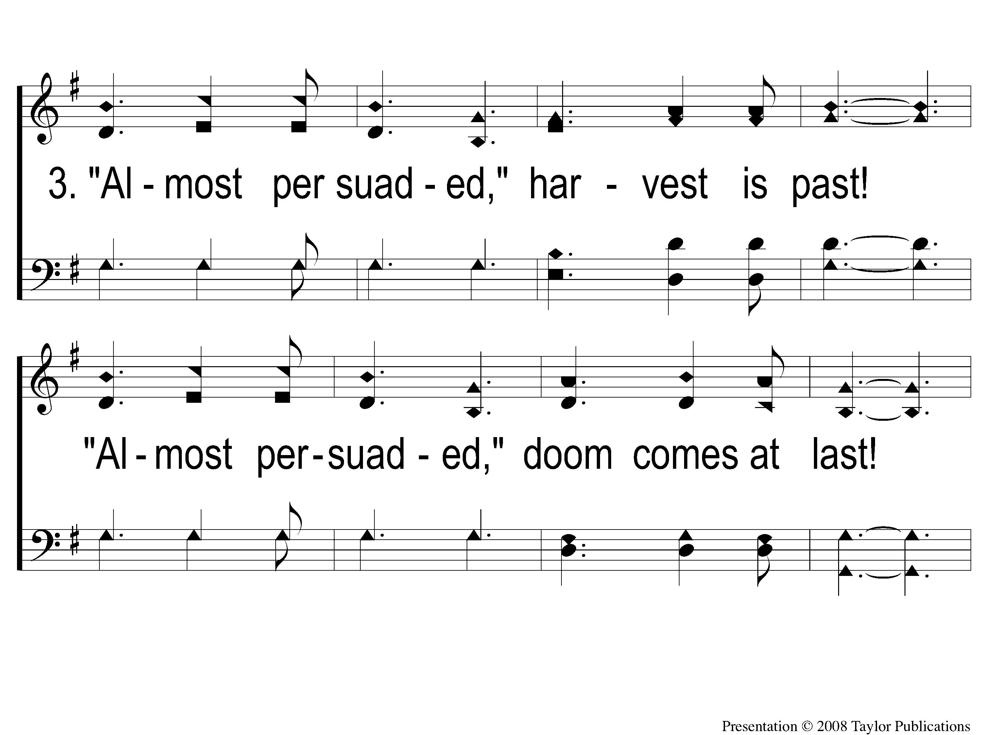
3-1 Almost Persuaded
Almost Persuaded
21

Slide 6
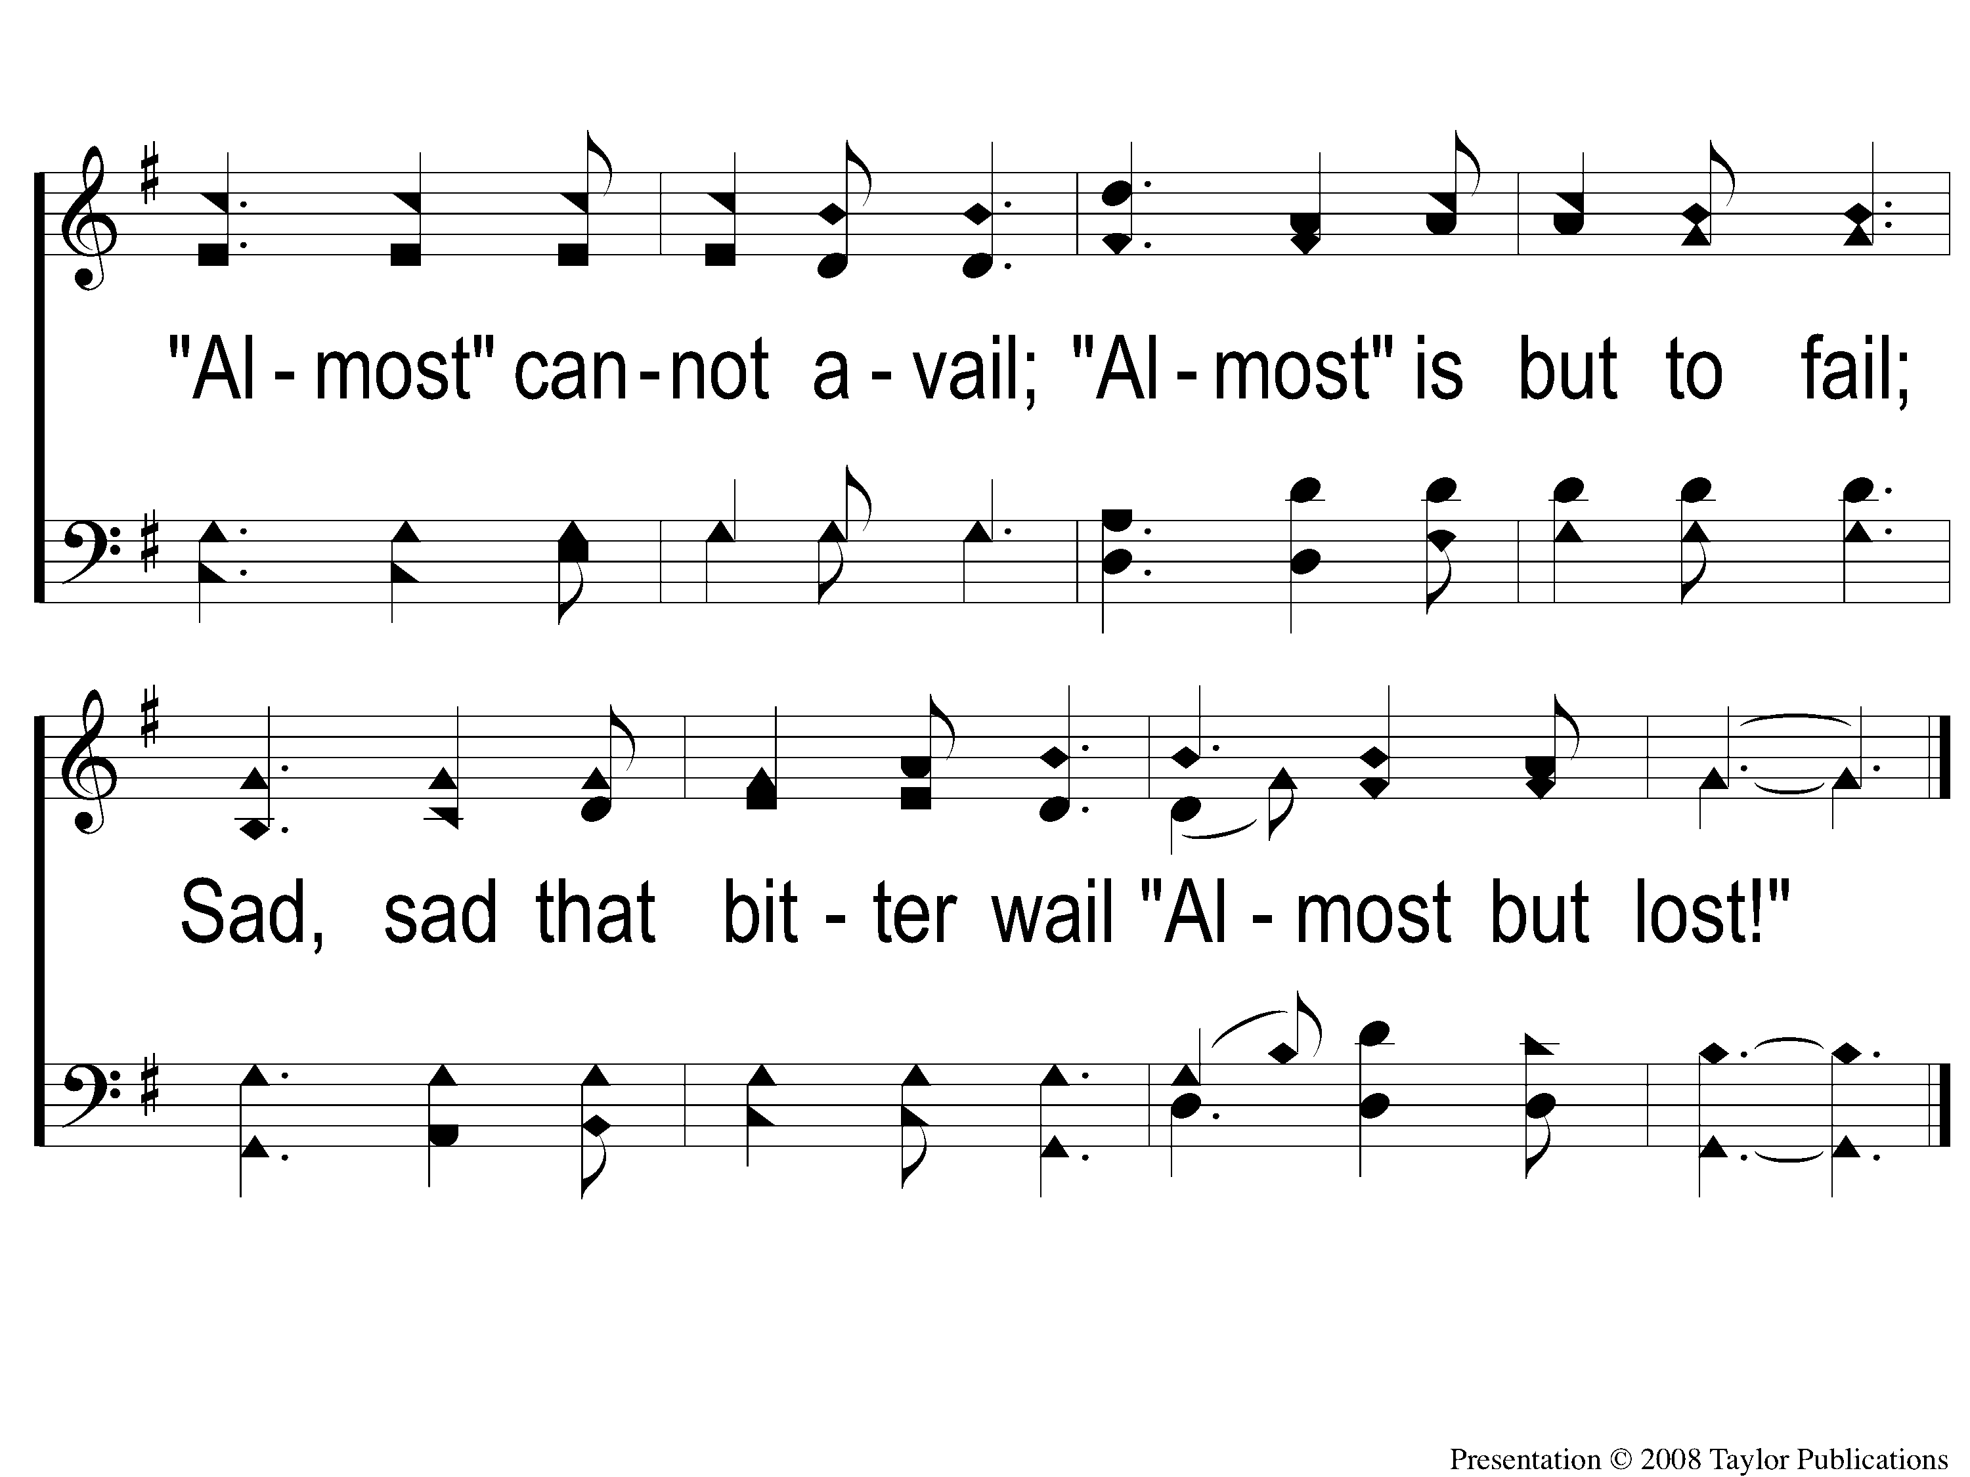
3-2 Almost Persuaded
Almost Persuaded
21

